Slide 1



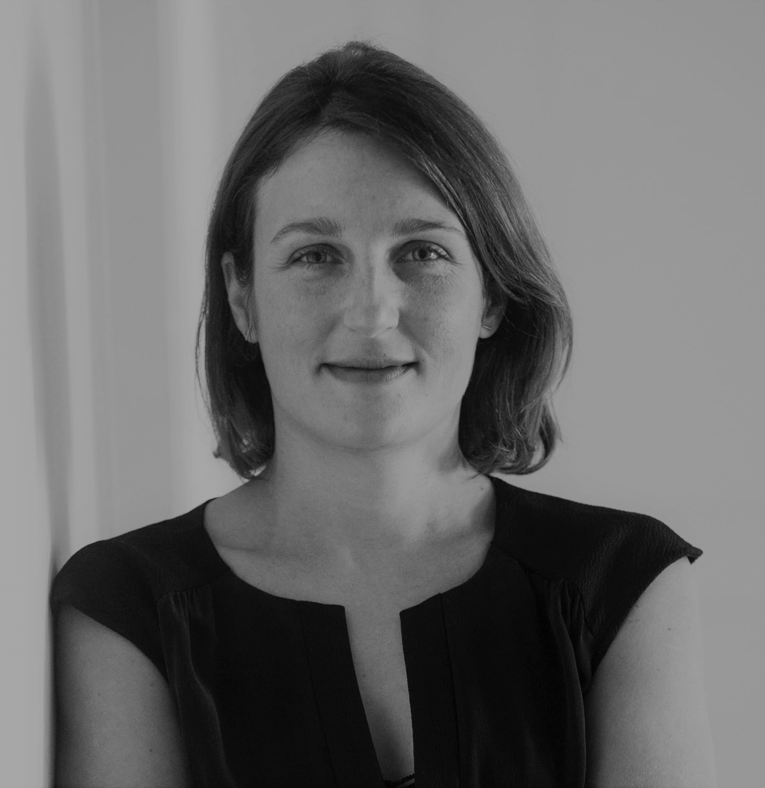

Cassandre Pignon – Mission Lead
Professional experience
Education and skills
4 years with McKinsey & Company based in Morocco with a strong focus on North and West Africa
Developed a sector-wide strategy for the Moroccan electricity sector, leading to complete sector restructuring and start of new green energy projects
Drove the implementation of a new agriculture strategy for the Moroccan Government (Plan Maroc Vert)
Direct support the Tunisian government to attract FDI in ITO/BPO and to negotiate support from the G8 post revolution
Supported the development of a leading commercial bank in West Africa
3 years in advisory roles serving African and Middle East Head of Governments and Ministers (Tony Blair Africa Governance Initiative, Office of the Quartet/UN)
In country postings included Ethiopia, Malawi, Sierra Leone, Liberia, Rwanda, and Israel / Palestinian Territories
Specialist on private sector development, and industrialization/industrial policy
Directly supported the Ethiopian Prime Ministry to set-up Industrial Park pipeline (1 billion USD) and execution on the Hawassa Industrial Park (250 million, major FDI in the Textile and Garment sectors)
5 years in infrastructure project bids and management (public transport, power production and distribution, water production and distribution, waste water treatment) – in Africa and MENA regions
Cassandre holds an MPA from the Harvard Kennedy School of Government where she focused on development economics
She also holds a Master of Engineering from the prestigious Ecole des Ponts et Chaussees in Paris and majored in Mathematics and Physics in her undergraduate studies (Classes Preparatoires)
A passionate traveler who has worked in Africa since 2002, Cassandre speaks French and English fluently and is able to have professional conversations in Spanish. She has basic knowledge in Arabic
Introduction
Cassandre is a French national with a dual qualification as Engineer (Ecole des Ponts et Chaussees) and Economist (Harvard).
She brings 12 years of experience on the African Continent, 4 of which with the McKinsey Public Sector Practice.
Cassandre has directly worked for 9 African governments and is a specialist on African industrialization.
I love working in Africa. It’s an exhilarating place to be. There is this incredible potential, and opportunities to impact the life of millions of people.

